Slide 1
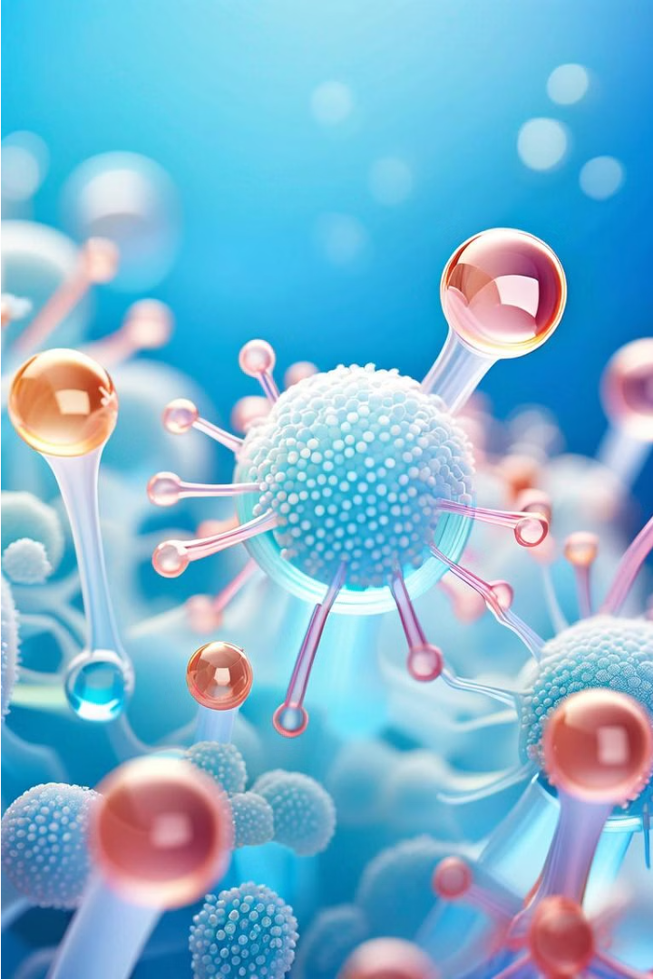

Image Processing for Biological Cell Segmentation
This project focuses on applying various image processing techniques to analyze and extract meaningful information from images of biological cell structures. By converting grayscale images into binary representations, the goal is to segment and highlight the cells for further analysis, such as counting, measuring, and studying their spatial distribution.
Yukthi - 20201CSE0678
Jayanth B S - 20201CSE0680
Sudarsh V - 20201CSE0683
Greeshma S - 20201CSE0712

Slide 2

Setting up the Environment
1
Clearing the Workspace
2
Defining Variables
The code starts by clearing the console, variables, and closing any open figures to ensure a clean working environment.
Key variables are set, such as frames per second (fps), input/output folders, and the image file extension, to streamline the image processing workflow.
3
Loading Example Images
The code loads an example image from the specified folder, which will be used for the subsequent image processing steps.

Slide 3
Exploring Image Histograms
Understanding Intensity Distribution
Preparing for Thresholding
Analyzing the histogram provides insights into the image's contrast and the potential challenges in separating the foreground (cells) from the background. This knowledge guides the selection of thresholding techniques.
The code displays the histogram of the original image, which helps to understand the distribution of pixel intensities. This information is crucial for selecting appropriate thresholding methods in the next step.

Slide 4
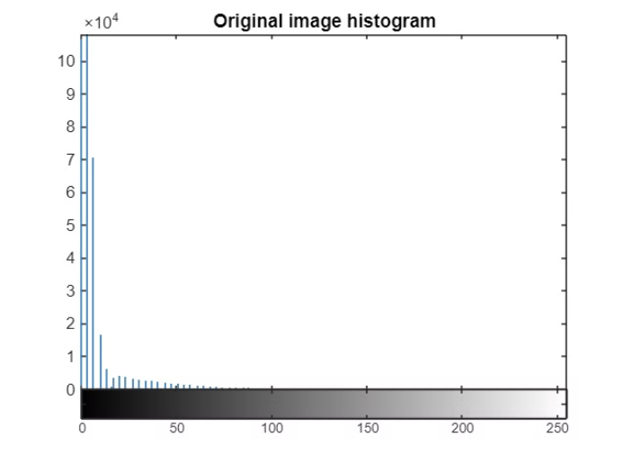
Thresholding Techniques
The image histogram provides crucial insights into the pixel intensity distribution within the cell images. By analyzing the histogram, we can identify optimal thresholding methods to effectively separate the foreground cells from the background.
Selecting the right thresholding approach is essential for creating high-quality binary representations of the cells, setting the stage for further analysis and feature extraction.

Slide 5
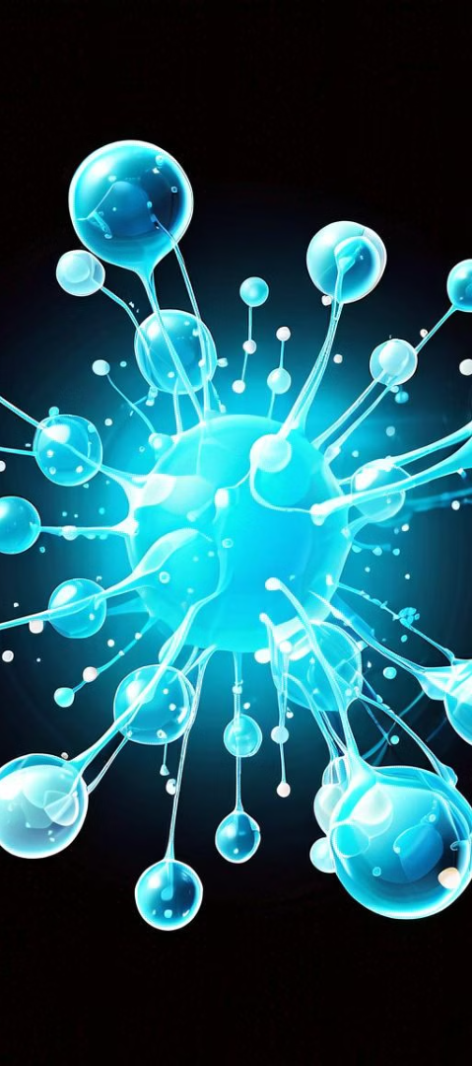
Thresholding Techniques
1
Otsu's Method
Otsu's method is an automatic thresholding technique that minimizes the intra-class variance, effectively separating the foreground (cells) from the background.
2
Median Thresholding
Median thresholding uses the median value of pixel intensities as the threshold, providing a robust approach to binarizing the image.
3
Mean Thresholding
Mean thresholding is based on the average pixel intensity, which can be useful for images with a more uniform intensity distribution.

Slide 6
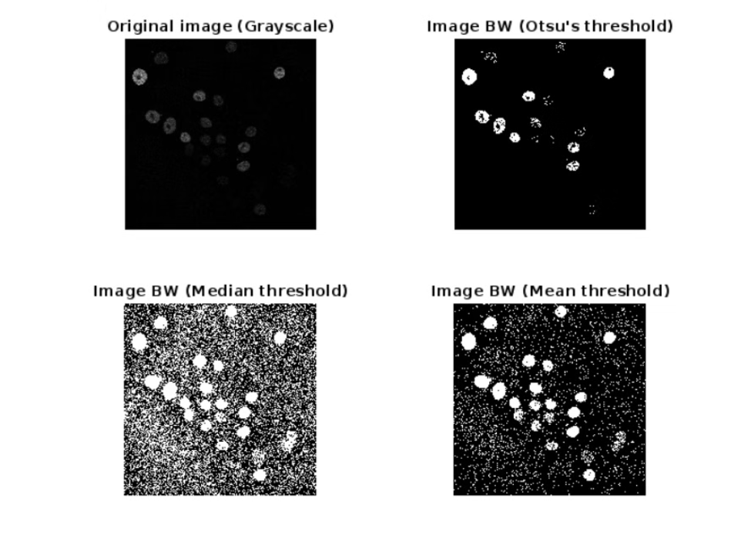
Evaluating Thresholding Techniques
Otsu's method produces images with less noise, but it tends to detect fewer cells compared to other techniques. The median thresholding approach captures more cells, but the resulting binary images contain more noise. The mean thresholding method strikes a balance, detecting a moderate number of cells with reduced noise levels.

Slide 7
Refining Binary Images
Median Filtering
Morphological Operations
Hole Filling
Median filtering is applied to the binary images to remove noise and preserve the edges of the cell structures.
The hole filling process ensures that the binary objects (cells) are closed and do not contain any internal holes, providing a more accurate representation of the cell structures.
Morphological operations, such as opening and closing, are used to further refine the binary images, removing noise and filling gaps within the cell structures.

Slide 8
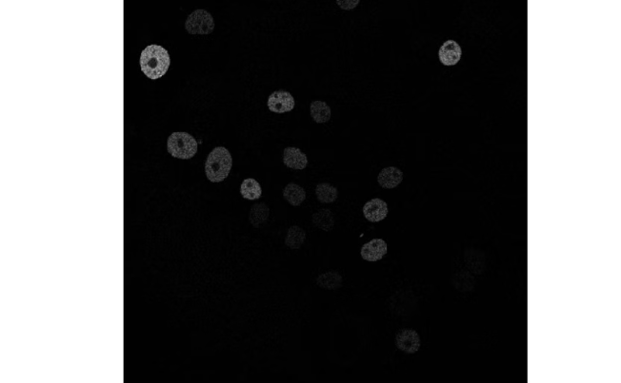
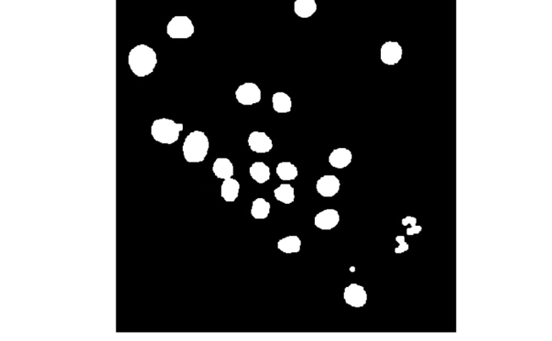
Input and Output: Image Processing for Cell Analysis
Original Cell Image
Processed Cell Image
The input image captured under a microscope displays the intricate details of biological cells, showcasing their diverse structures and features.
The output image demonstrates the effectiveness of the image processing techniques, providing a clean and enhanced representation of the cell structures for further analysis.

Slide 9
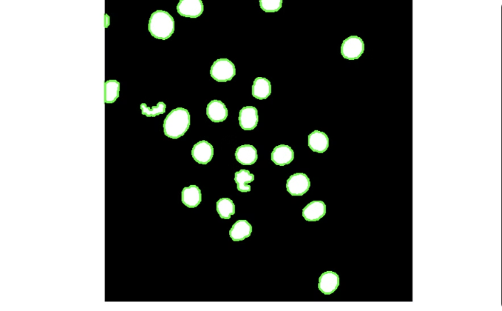
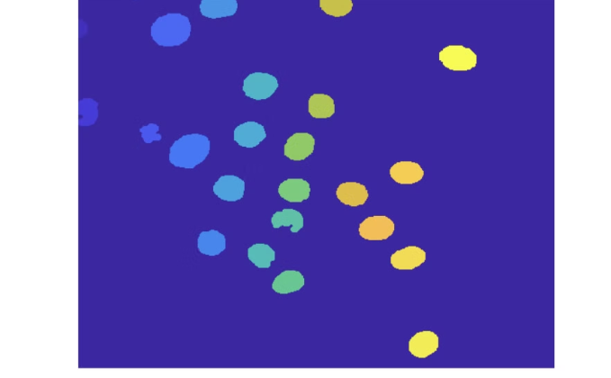
Cell Boundary Detection and Cell Counting
Cell Segmentation Algorithm
Automated Cell Counting
The cell segmentation algorithm labels each distinct cell in the image, allowing us to quantify the number of cells present and analyze their individual characteristics.
The automated cell counting feature provides a precise enumeration of the number of cells in the image, enabling detailed quantitative analysis of the sample.

Slide 10

Objectives
Noise Reduction
Feature Extraction
Comparison of Thresholding Methods
Morphological Operations

Slide 11
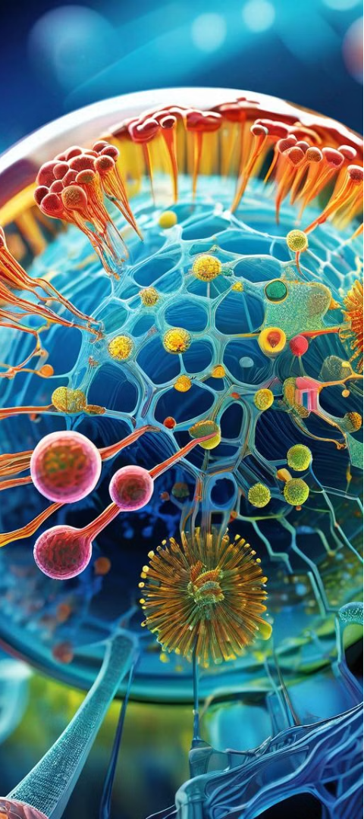



Conclusion
Extraction
The project demonstrates the application of various image processing techniques, such as thresholding and morphological operations, to segment and extract meaningful information from biological cell images.
Enhancing Image Quality
By combining different thresholding methods and image processing steps, the project aims to improve the quality of the binary images, ensuring accurate representation of the cell structures.
Enabling Further Analysis
The processed binary images can be used for a range of analyses, including cell counting providing valuable insights for biological research and applications.

Slide 12
Future Directions
Automation and Scalability
Integrating Machine Learning
Collaborative Research
Fostering interdisciplinary collaborations with biologists, computer scientists, and domain experts to continuously improve the image processing methods and expand the applications of this project.
Exploring ways to automate the image processing workflow and scale it to handle larger datasets, enabling efficient and high-throughput analysis of biological cell structures.
Investigating the potential of incorporating machine learning techniques, such as deep learning, to further enhance the accuracy and robustness of cell segmentation and analysis.

